Slide 1
MTN-028
Laboratory Training
May Beamer, Lorna Rabe
MTN Laboratory Center
Magee-Womens Research Institute
Pittsburgh, PA

Slide 2
Objectives
Resources
Specimen Management
Overview of Lab testing
Supplies
Q&A
Notes:
Urine
Blood specimens
HIV testing algorithm
Pelvic exam checklist

Slide 3
Resources
MTN LC: Magee-Womens Research Institute
  Lorna Rabe 412-641-6041 lrabe@mwri.magee.edu
  May Beamer: 412-641-6026 mbeamer@mwri.magee.edu
  Wayne Hall, Ted Livant
SSP Section 9: Lab Considerations
    Most current version
      www.mtnstopshiv.org
    Lab SSP Tables

Slide 4
Specimen Management slide 1
Specimen Labeling (Section 9.2, page 9-4)
  SCHARP-provided participant ID (PTID) label.
    Include Collection date and Visit code.
    If information is handwritten, use indelible ink.
  LDMS labels for aliquots stored for MTN LC.
Special Circumstances (Section 9.3, page 9-4)
  Collection of a specimen will be repeated if samples cannot be tested (Ex. Purple Top broke on transit to the lab).
  A protocol deviation (PD) form may be required in cases when additional specimens are collected either due to a laboratory or clinic error.

Slide 5
Specimen Management slide 2
Specimen Handling and Chain of Custody SOP
  Local Lab Requisitions
    Results from samples collected BEFORE randomization are reported on ELIGIBILITY CHECKLIST.
    Results from samples collected AFTER randomization are reported on a CRF.
  Lab Checklist
    Includes Laboratory Data and Management System (LDMS) information requested by MTN LC
      No separate LDMS tracking sheet

Slide 6
Lab Checklist (example)

Slide 7
LDMS (Section 9.4)
  Samples stored for MTN LC
  Tables 9-3 and 9-4
Lab Checklist must include:
  Collection times for PK samples, plasma archive
  Pre and post weights
    Make sure post weight is larger
  Net Weight for PK VAG or PK CX biopsy
    The average weight for vag PK is ~81 mG (65-115 mG)
  Freeze times
Notes:
Plasma for archive and PK, vaginal smear, vag for PK, cervical biopsy for PK, vaginal ring

Slide 8
Urine Specimens
Specimen collection (9.5.1)
hCG (Section 9.5.2)
  Beckman Coulter ICON 25
  Required at Screening and Enrollment: Eligibility Checklist
  Required at Day 14 and Day 28: Follow Up Visit Summary CRF
Dipstick urinalysis (Sections 9.5.3, 9.5.4)
  Roche Chemstrip 5OB test strips
  Required glucose and protein at Screening and Day 28
  If clinically indicated, leukocytes and nitrites
    Urine culture, proceed per local standard of care
  Safety Laboratory Results CRF

Slide 9
Blood Specimens slide 1 per local lab requirements
Hepatitis B Surface Antigen (Section 9.6.5)
  Required only at Screening: Eligibility Checklist
Hepatitis C Antibody (Section 9.6.5)
  Required only at Screening: Eligibility Checklist
Coagulation, INR (Section 9.6.2)
  Required only at Screening: Eligibility Checklist
Complete Blood Count with Differential and Platelets (Section 9.6.2)
  Required at Screening and Enrollment: Eligibility Checklist
  Required at Day 28 and if indicated at Day 35: Safety Laboratory Results CRF
Notes:
Not listed in any collection order
LAB CHECKLIST has their collection order

Slide 10
Blood Specimens slide 2 per local lab requirements
Chemistries: AST, ALT, creatinine (Section 9.6.2)
  Creatinine clearance calculator
  Required at Screening and Enrollment: Eligibility Checklist
  Required at Days 28 and 35: Safety Laboratory Results CRF
Syphilis Serology (Section 9.6.4)
  Required at Screening: Eligibility Checklist
  If clinically indicated at follow-up visits: STI Test Results CRF
HIV-1 Testing (Section 9.6.3)
  Required at Screening and Enrollment: Eligibility Checklist
  If clinically indicated at follow-up visits and required at Day 35.
    HIV Results CRF, HIV Confirmation CRF
  HIV Testing Algorithm

Slide 11
HIV
Algorithm
Notes:
Screening Participants (to include HIV testing for Enrollment visit)
Until enrolled, treat enrollment testing same as screening participants.
If the confirmatory test (performed at the local lab) is neg, indeterminate or invalid, contact the Virology LC.
If the confirmatory test is pos, the participant is considered HIV infected.
Note: If there is insufficient sample for confirmation testing at the local lab, the participant will be redrawn and this will still be considered sample 1.
Follow-Up Participants (only enrolled participants)
Confirmatory test on Sample 1 is neg, Ind or invalid, then contact the Virology LC for further guidance.
Confirmatory test on Sample 1 is pos, draw a second specimen (Sample 2)
Used for additional confirmatory testing by the MTN Virology LC
Ship at least 3 aliquots to Virology LC Immediately!
Confirmatory test on Sample 2 is pos, the participant is HIV infected.
Confirmatory test on Sample 2 is neg, Ind or invalid, Virology LC will provide guidance
In addition, draw extra blood if required for local standard of care.

Slide 12
Blood Specimens, Stored for MTN LC
Plasma archive (Section 9.6.6)
  Lab Checklist (LDMS)
  Required at Enrollment: Enrollment CRF
  If indicated at follow-up, collect for confirmation of viral load and HIV drug resistance
Plasma for PK (Section 9.6.7)
  Lab Checklist (LDMS)
  Enrollment, Pharmacokinetics Specimens—Enrollment CRF
    Timer towards 1 HR collection point starts when ring is inserted
  Single time points, Pharmacokinetics Specimens—Days 1, 2, 3, 7, 14, 21, 29, 30, 31, 35 CRF
  Day 28, Pharmacokinetics Specimens—Day 28 CRF
    0 HR sample just before ring removal
    Timer towards 1 HR collection point starts after ring removal
  Storage: Primary set, Backup set

Slide 13
Pelvic Exam Checklist slide 1
Vaginal Specimens
Rapid Trichomonas, per OSOM rapid kit (section 9.7.4)
  Required at Screening: Eligibility Checklist
  If clinically indicated at other visits
    STI Test Results CRF
Bacterial vaginosis or candidiasis, if clinically indicated, any visit (section 9.7.2)
  Saline wet mount for clue cells for BV
  KOH for whiff test for BV
  KOH wet mount for candidiasis
  pH for BV
  STI Test Results CRF
Notes:
In order of pelvic exam checklist
History and exam

Slide 14
Amsel’s Criteria
Must have at least 3 of the 4 following:
  Thin homogeneous discharge
  Amine odor
  pH >4.5
  >20% Clue cells

Slide 15
Pelvic Exam Checklist, slide 2
Vaginal Specimens
Gram stain (Section 9.7.1)
  Required at Enrollment, Days 3, 28, and 35
  Specimen Storage CRF and Lab Checklist (LDMS)
  Storage
    Primary slide box 1
    Duplicate in slide box 2
  GC/CT NAAT, per Gen-Probe Aptima (Section 9.7.3)
  Required at Screening: Eligibility Checklist
  If clinically indicated at follow-up: STI Test Results CRF

Slide 16
Vaginal Swab for PK (Section 9.7.5)
  Enrollment
    Pharmacokinetics Specimens—Enrollment CRF
    Record collection time Lab Checklist (LDMS)
    0 HR: after randomization, prior to ring insertion.
    Ring insertion time, subsequent collection time targets
      Blood for PK collected first
      Vag PK collected within 5 min of blood draw
Notes:
Importance of recording collection time
Delay in collection does not impact next collection time
Missed collection
Discussion if mock run performed:
Performed at each designated time-point.
Instruct the patient on how to collect the sample
Use Illustration found in the Study Implementation Materials to help explain process.
Site has option to have staff or participant break shaft.
Everything gets placed back into the bag (you may want to remove trash cans from patient area).
Make sure cap is on tight!
If a swab hits the ground, or the shaft is splintered, have a back-up kit ready.

Slide 17
ENR Specimen Flow Chart
Urine hCG a
Speculum a
Pelvic Exam a
Gram stain swab a
Removal of speculum a
Blood draw
  AST, ALT, Creatinine, Plasma Archive, CBC w Diff & Plt, HIV [Rapid Test]
Eligibility/Randomization a
Collect Vag PK self-collect swab ( hour 0) a
Ring insertion (timer starts for subsequent time point collections) a
Exam to check ring placement (no speculum needed) a
Collect remaining serial PK samples relative to timing of ring insertion
Notes:
Required samples listed
Blood draw is moved to just prior to randomization

Slide 18
Vaginal Swab for PK (Section 9.7.5)
Single time point
    Self-collection done within ~1 hour of blood draw for PK
    Pharmacokinetics Specimens—Days 1, 2, 3, 7, 14, 21, 29, 30, 31, 35 CRF.
Day 28
    0 HR, just before ring removal, after blood draw for PK
    Pharmacokinetics Specimens—Day 28 CRF
    Ring removal time, subsequent collection time targets for PK
      Blood for PK collected first
      Vag PK collected within 5 min of blood draw
  Self collected
Notes:
Importance of recording collection time
Delay in collection does not impact next collection time
Missed collection
Discussion if mock run performed:
Performed at each designated time-point.
Instruct the patient on how to collect the sample
Use Illustration found in the Study Implementation Materials to help explain process.
Site has option to have staff or participant break shaft.
Everything gets placed back into the bag (you may want to remove trash cans from patient area).
Make sure cap is on tight!
If a swab hits the ground, or the shaft is splintered, have a back-up kit ready.

Slide 19
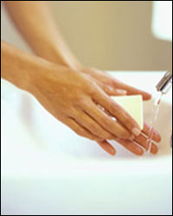
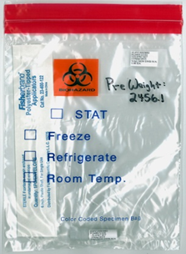
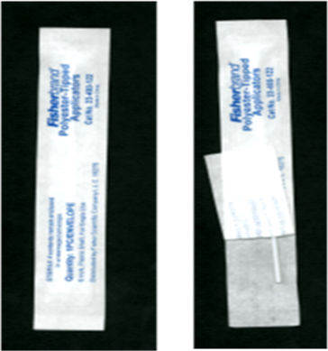
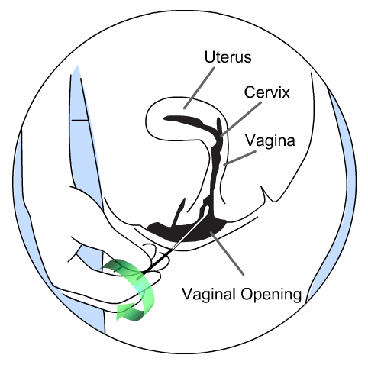
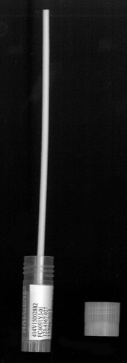

Self-Collected Swab for PK
1
2
3
4
5
6
7
8
9
10
Notes:
Ask site to what extent will the site help the participant before and after the collection.
(2) shouldn’t have writing on the bag unless it is written BEFORE the weight is taken.
(3) Also unscrew the top from the cryovial – will a rack be available/necessary?
Completed SCHARP label should be on the cryovial before pre-weigh
(4) Do not throw out swab packaging – do not have a garbage can in the room?
(6) Will the next step be (7) participant hand clinic/lab staff the tube/swab ensemble? Or (8) carefully break off the shaft on their own?
(9) Screwed on tight immediately.
(10) Should include swab packaging, swab shaft and tightly screwed cryovial containing swab.

Slide 20
Intravaginal Ring Storage (Section 9.7.6)
  Remnant content analysis
  Prepare ring for storage if ring that is removed prematurely is not re-inserted.
  Day 28
  0 HR blood and vag for PK, BEFORE IVR removal.
  Specimen Storage CRF
  Safety from aerosol
  Mold-prevention: Must be dry before bagged
  Storage
Notes:
Stress safety PPE
Protect against aerosol, bleach/autoclave or one time use containers
Discard liquid rinse appropriately (e.g. toilet)

Slide 21
Pelvic Exam Checklist
Cervical Specimens (Section 9.8)
Pap Test per local standard of care
  If indicated at Screening
Cervical Biopsy
  Required at Day 28, shortly after ring removal
  Lab Checklist (LDMS)
  PK-Day 28 CRF
  Sample preparation for storage
Notes:
Discuss dry ice/ethanol bath (possibly in styrofoam cup to minimize volume, then in ice bucket in case cup weakens)
Safety: appropriate gloves, eye protection
CX BIOPSY on a CRF?

Slide 22
Shipping instructions, batched for end of study
Specimens to MTN LC
  Plasma archive
  Used vaginal rings
  Vaginal smears (Will notify when to discard duplicate smears or ship to LC)
Specimens to MTN LC CAVP
  Plasma for PK
  Vaginal swabs for PK
  Cervical biopsy for PK

Slide 23
Supplies Provided by MTN LC
  Sterile polyester-tipped swabs
    vaginal smear, swab for PK
  Slides with frosted ends
    vaginal smear
  Slide storage boxes
    vaginal smear
  Cryovials for vaginal PK swabs
  Amber zippit bag: IVR

Slide 24
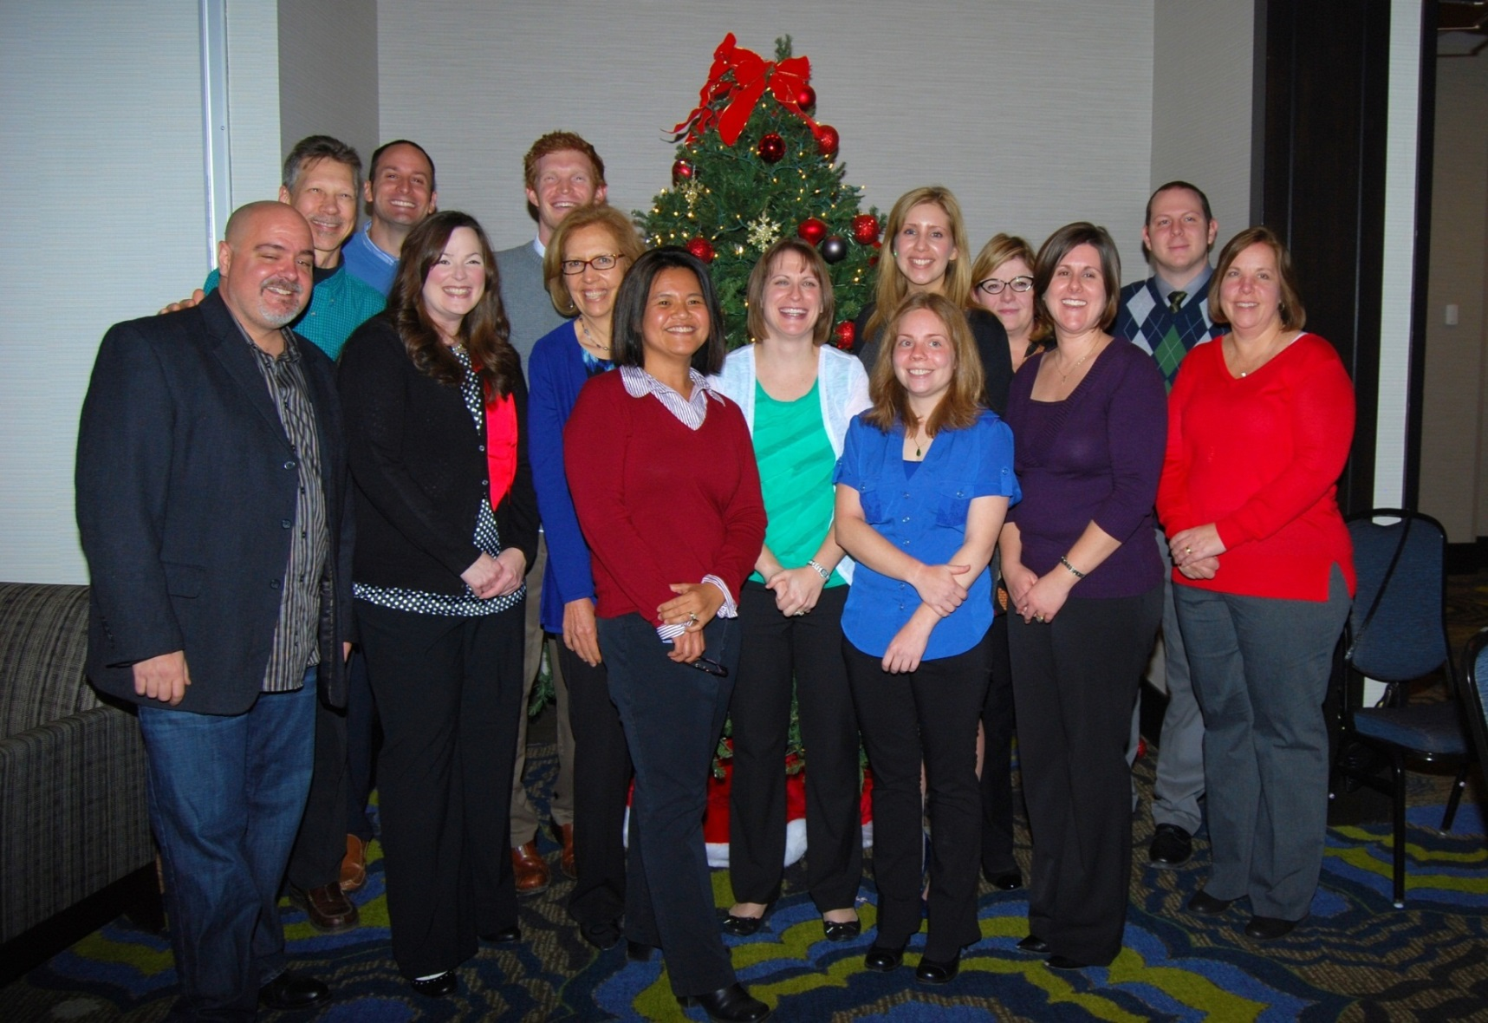
Questions?
Notes:
Hillier Lab

